Slide 1
Ecosystems: Lesson 5, Activity 1
Farm Ecosystem

Slide 2
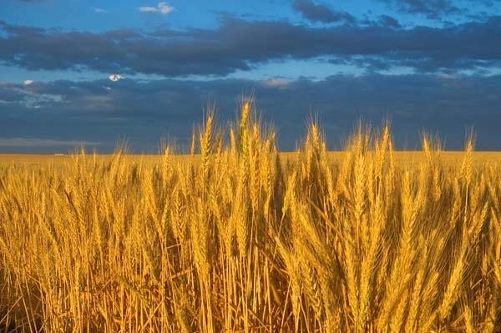
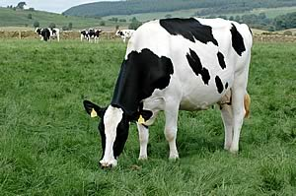
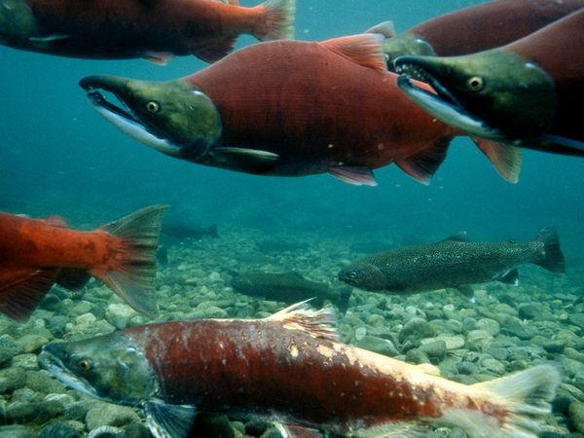
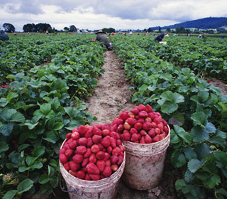
Humans are part of ecosystems too!
Notes:
http://justplainpix.com/Open_Ediiton/Open_Edition_Landscapes/slides/Wheat-Field.html
http://www.freewebs.com/sac875/cows.htm
http://animals.nationalgeographic.com/animals/fish/sockeye-salmon/
http://www.rodale.com/methyl-iodide-0

Slide 3
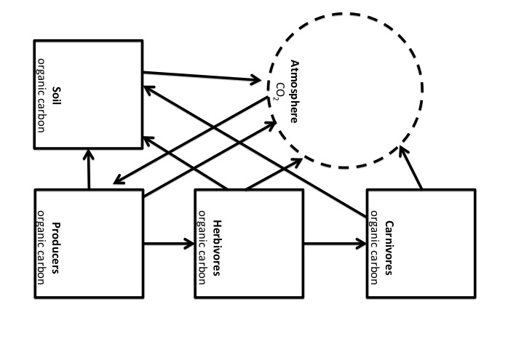
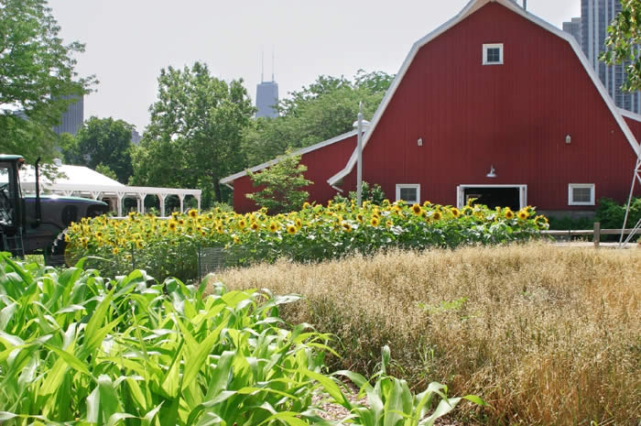
Let’s look at pools and fluxes in terms of a human food ecosystems

Slide 4
Where do you think humans are located in the diagram to the right?
Notes:
People eat both plants and animals, so people could be considered as either herbivores or carnivores.

Slide 5
Think about 7 Billion Humans…
That’s a lot of food!!
And the number of people on Earth is increasing.
Food production takes a lot of resources.
How do we get the most number of people with the least amount of food?

Slide 6
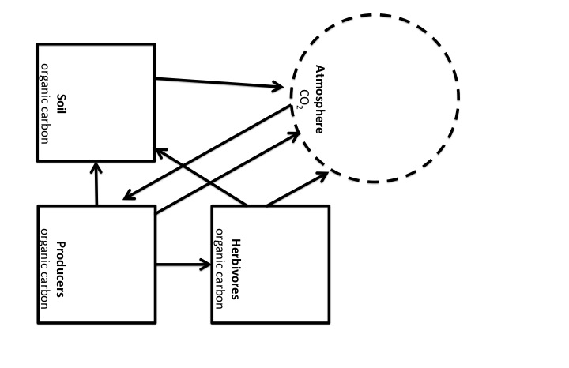
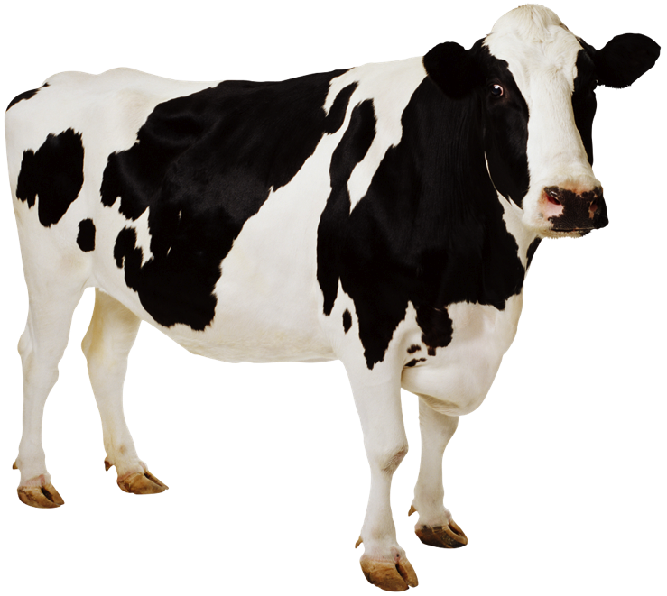
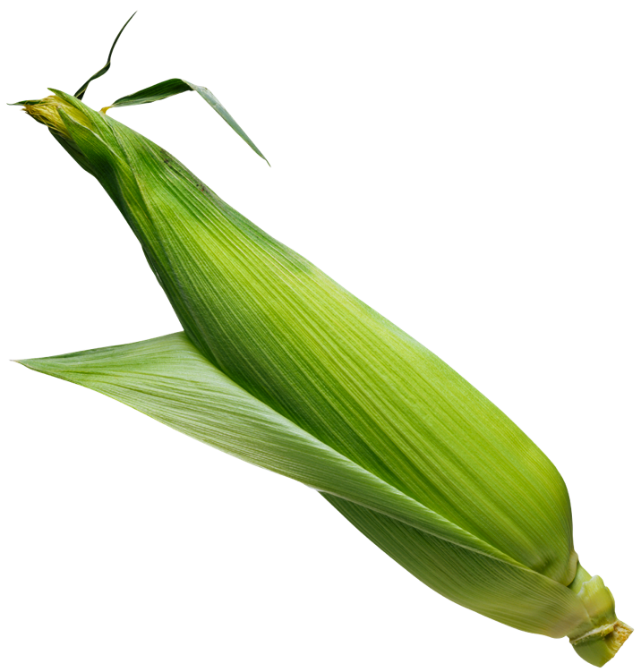
Let’s compare: Where do we get the greatest number of people with the least amount of food?
Humans are herbivores
Humans are carnivores
Notes:
Pictures from PPT clipart

Slide 7
In this ecosystem, we’ll think of corn as the only producers. And either humans or cows as the only herbivores.
Let’s say we need at least 1 carbon atom unit to make one human.
Humans are herbivores
Humans are carnivores
Notes:
Pictures from PPT clipart

Slide 8
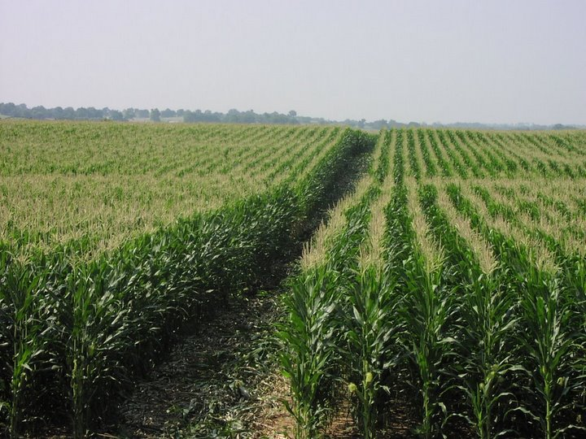
Corn plant photosynthesis occurred, so there are 500 carbon atom units are in the producers pool.
500
Notes:
Cornfield photo: http://blog.risingbricsam.com/?attachment_id=1441

Slide 9
Corn plant cellular respiration occurs.
200 carbon atom units move from the producers to the atmosphere.
200
200
500
-200

Slide 10
Some corn plants die.
100 carbon atom units move from the producers to the soil.
200
200
100
500
-200
-100
100

Slide 11
Corn gets eaten by people!
100 carbon atom units move from the producers to the herbivore pool.
200
100
200
100
100
500
-200
-100
100
-100

Slide 12
One of three things can happen to food (corn) in a person’s stomach:
1) People digest food & respire.
50 carbon atom units move from the herbivores to the atmosphere.
200
+50
50
100
200
-50
100
100
500
-200
-100
100
-100

Slide 13
One of three things can happen to food (corn) in a person’s stomach:
2) People defecate indigestible food. (ew!)
Also, sometimes people die. (sorry!)
50 carbon atom units move from the herbivores to soil.
200
+50
50
100
200
-50
-25
25
100
100
500
+25
-200
-100
100
-100

Slide 14
One of three things can happen to food (corn) in a person’s stomach:
3) People digest & biosynthesize
Large molecules in corn are broken down into small molecules.
Small molecules are made into a person’s biomass.
200
+50
50
100
200
-50
-25
25
100
100
500
+25
-200
-100
100
-100

Slide 15
Add it up!
How much carbon is available to humans when they are herbivores?
200
+50
50
100
200
-50
-25
25
100
100
500
+25
-200
-100
100
-100

Slide 16
There are 25 carbon atom units left in the herbivore pool.
If we need 1 carbon atom units per human…
25 humans can live on an herbivore diet.
250
50
200
25
25
100
125
100
100

Slide 17
Let’s compare: Where do we get the greatest number of people with the least amount of food?
Humans are herbivores
Humans are carnivores
Notes:
Pictures from PPT clipart

Slide 18
Corn plant photosynthesis occurred, so there are 500 carbon atom units are in the producers pool.
500

Slide 19
Corn plant cellular respiration occurs.
200 carbon atom units move from the producers to the atmosphere.
200
200
500
-200

Slide 20
Some corn plants die.
100 carbon atom units move from the producers to the soil.
200
200
100
500
-200
-100
100

Slide 21
Corn gets eaten by cows! (moo)
100 carbon atom units move from the producers to the herbivore pool.
200
100
200
100
100
500
-200
-100
100
-100

Slide 22
One of three things can happen to food (corn) in a cow’s stomach:
1) Cows digest food & respire.
50 carbon atom units move from the herbivores to the atmosphere.
200
+50
50
100
200
-50
100
100
500
-200
-100
100
-100

Slide 23
One of three things can happen to food (corn) in a cow’s stomach:
2) Cows defecate indigestible food. (ew!)
Also, sometimes cows die.
25 carbon atom units move from the herbivores to soil.
200
+50
50
100
200
-50
-25
25
100
100
500
+25
-200
-100
100
-100

Slide 24
One of three things can happen to food (corn) in a cow’s stomach:
3) Cows digest & biosynthesize
Large molecules in corn are broken down into small molecules.
Small molecules are made into a cow’s biomass.
200
+50
50
100
200
-50
-25
25
100
100
500
+25
-200
-100
100
-100

Slide 25
Cows got eaten by people! (Burgers anyone?)
15 carbon atom units move from the herbivores to carnivores.
15
200
+50
50
15
100
200
-50
-25
-15
25
100
100
500
+25
-200
-100
100
-100

Slide 26
One of three things can happen to food (cows) in a person’s stomach:
1) People digest the food & do cellular respiration.
6 carbon atom units move from the carnivores to the atmosphere.
15
-6
6
200
+50
+6
50
15
100
200
-50
-25
-15
25
100
100
500
+25
-200
-100
100
-100

Slide 27
One of three things can happen to food (cows) in a person’s stomach:
2) People defecate indigestible food.(ew)
Also, sometimes people die. (sorry!)
6 carbon atom units move from the carnivores to the soil.
15
-6
-6
6
200
+50
+6
6
50
15
100
200
-50
-25
-15
25
100
100
500
+25
-200
+6
-100
100
-100

Slide 28
One of three things can happen to food (cows) in a person’s stomach:
3) People digest the food & biosynthesize
Large molecules in people are broken down into small molecules.
Small molecules are made into people’s biomass.
15
-6
-6
6
200
+50
+6
6
50
15
100
200
-50
-25
-15
25
100
100
500
+25
-200
+6
-100
100
-100

Slide 29
Add it up!
How much carbon is available to humans when they are carnivores?
15
-6
-6
6
200
+50
+6
6
50
15
100
200
-50
-25
-15
25
100
100
500
+25
-200
+6
-100
100
-100

Slide 30
3
There are 3 carbon atom units left in the herbivore pool.
If we need 1 carbon atom units per human…
3 humans can live on an carnivore diet.
256
10
136
100

Slide 31
3
250
250
256
50
50
10
25
200
25
200
25
25
100
100
125
125
136
100
100
100
100
100

Slide 32
The Three Questions at the Large Scale
Can you answer the Three Questions at the Large Scale for the Farm Ecosystem?

Slide 33
The Location Question
Where are the available carbon atoms in ecosystems?
What pools of materials are they in?
Rules to Follow:
Atoms endure.
Carbon atoms stay in pools unless a process moves them in or out.

Slide 34
The Carbon/Movement Question
How/why do carbon pools change over time?
How are carbon atoms moving?
Rules to Follow:
Carbon cycles.
Carbon-transforming processes move carbon atoms from carbon dioxide to organic molecules and back again.

Slide 35
The Energy Question
Where does the chemical energy in ecosystems come from?
How is chemical energy transformed in ecosystems?
Where does chemical energy go?
Rules to Follow:
Energy Flows.
Carbon-transforming processes change energy from:
sunlight to
chemical energy to
heat

